Slide 1
Server Management
Members:
1. Shreyansh Dubey
2.Harshwardhan Mehrotra
3.Soham Dhandhe
4.Viren Ghuikhedkar

Slide 2
Problem Statements:
In this pandemic everyone had to work from home and the work of a system administrator get extremely difficult as he might have to manage many servers and also manage there passwords and keys
We can ease this process of server management by making all the servers accessible using one application with One Click Login process.

Slide 3
Scope Of Project
Create a system to encrypt all the data that is stored on the device(ssh keys, passwords,etc)
Create a Monitoring Panel
Create a SSH Terminal

Slide 4
Uses
Server Management
Resource Monitoring(In App)
Password Manager

Slide 5
Social Aspects:
Will improve work from home to smoothen up the server access process.
Will be a single platform for all kinds of server management needs
Will make access servers secure by being the only path to connect to the internal servers

Slide 6
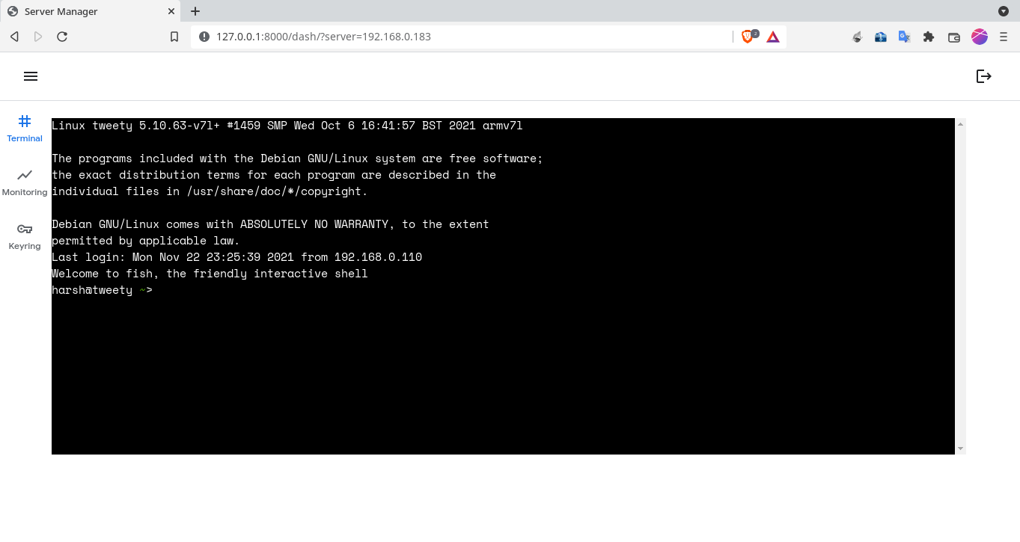
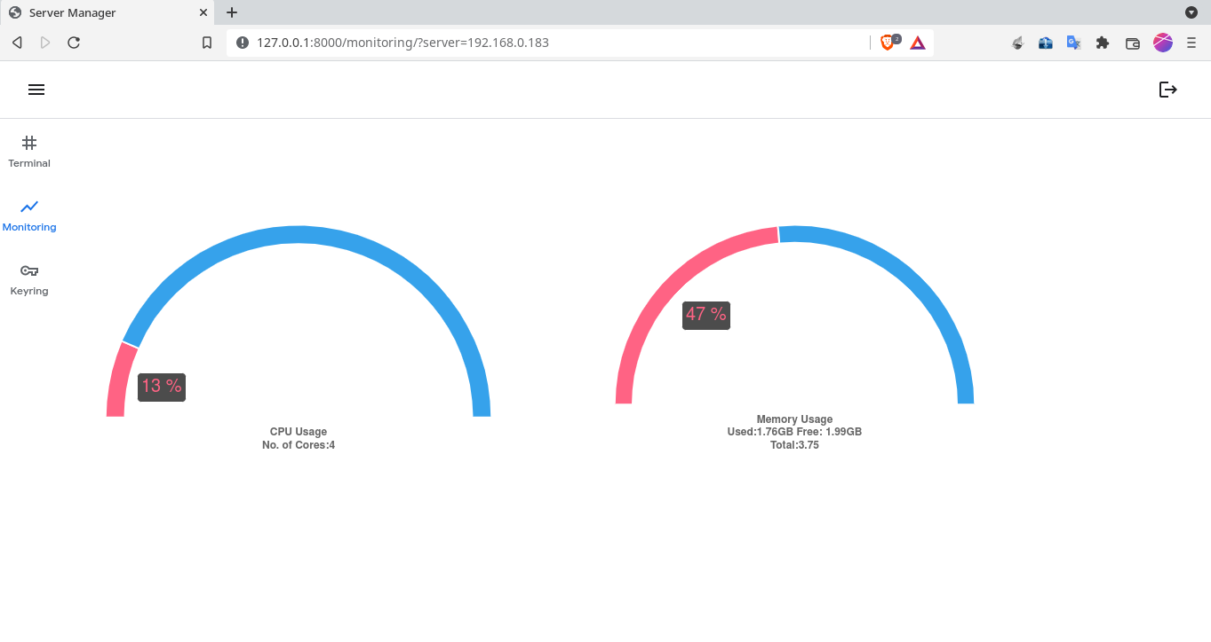
Output

Slide 7
Program Code
https://github.com/harsh18262/server_manager_django

Slide 8
Code
And
Demonstration

Slide 9
Conclusion

Slide 10
Thank You

